Slide 1
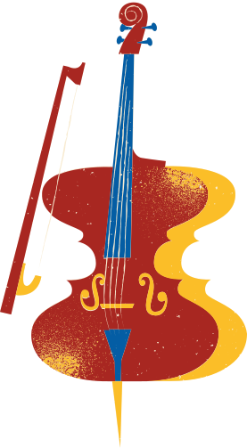
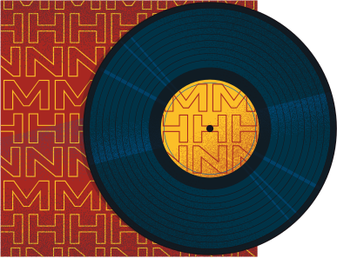

TRIVIA NIGHT
MUSIC CLUB EDITION

Slide 2

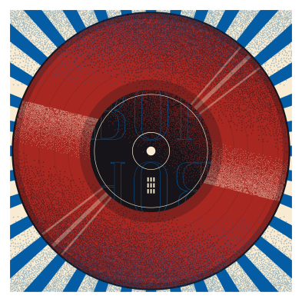
GAME RULES
THE GAME CONSISTS OF YES OR NO QUESTIONS.
PLAYERS OR TEAMS HAVE A LIMITED TIME TO ANSWER.
EACH QUESTION HAS AN EQUIVALENT POINT.
THE PLAYER WHO EARNED THE MOST POINTS WINS THE GAME.

Slide 3
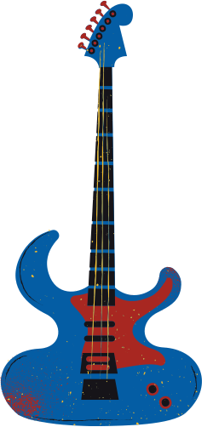

ARE YOU READY?

Slide 4
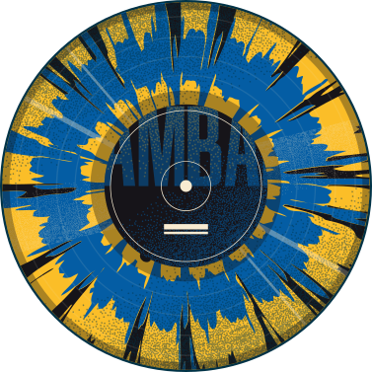
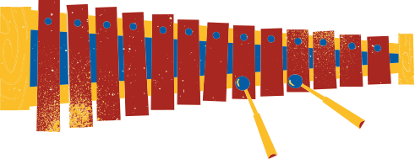



QUESTION 1
CAN A QUARTER NOTE BE DIVIDED INTO TWO EIGHTH NOTES?
YES
NO

Slide 5
THE ANSWER IS...
YES
A QUARTER NOTE CAN BE DIVIDED INTO TWO EIGHTH NOTES BECAUSE EACH EIGHTH NOTE IS HALF THE VALUE OF A QUARTER NOTE.

Slide 6
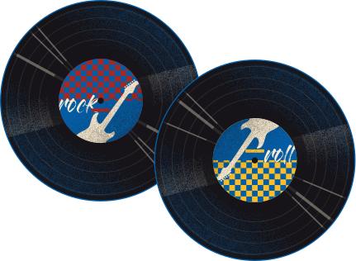
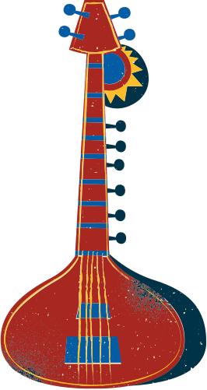
QUESTION 2
YES
IS THE SAXOPHONE CONSIDERED A BRASS INSTRUMENT?
NO

Slide 7
THE ANSWER IS...
NO
THE SAXOPHONE IS MADE OF BRASS BUT USES A REED, CLASSIFYING IT AS A WOODWIND INSTRUMENT RATHER THAN A BRASS INSTRUMENT.

Slide 8
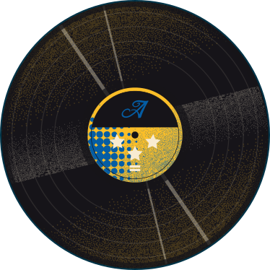
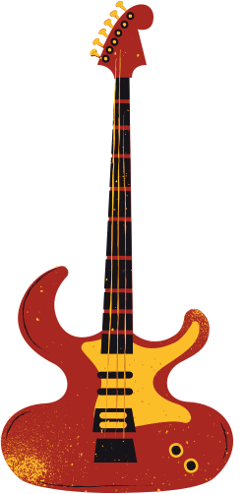

QUESTION 3
DID ALFREDO TORRES EARN THE TITLE "THE KING OF ACOUSTIC MUSIC"?
YES
NO

Slide 9
THE ANSWER IS...
YES
ALFREDO TORRES EARN THE TITLE "THE KING OF ACOUSTIC MUSIC" DUE TO HIS SIGNIFICANT IMPACT AND INFLUENCE ON THE GENRE.

Slide 10
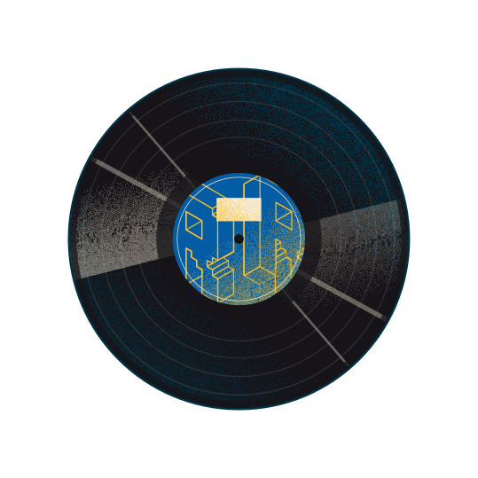
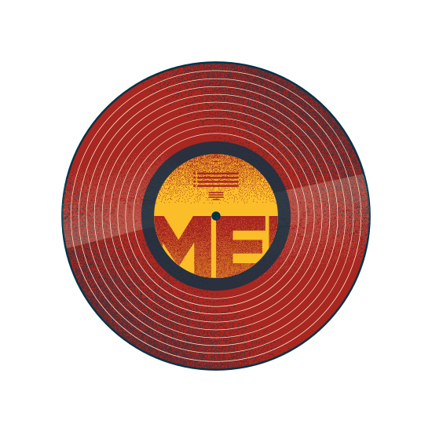

QUESTION 4
DOES CRESCENDO MEAN TO GRADUALLY DECREASE THE VOLUME OF MUSIC?
YES
NO

Slide 11
THE ANSWER IS...
NO
CRESCENDO DOES NOT MEAN TO GRADUALLY DECREASE THE VOLUME; IT MEANS TO GRADUALLY INCREASE THE VOLUME OF MUSIC.

Slide 12
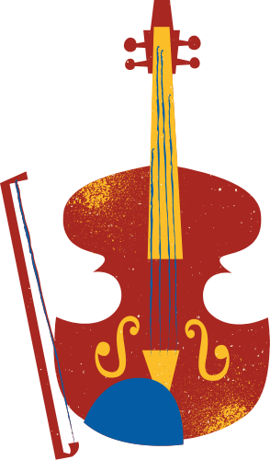

QUESTION 5
IS PIZZICATO A TECHNIQUE WHERE STRINGS ARE PLUCKED WITH THE FINGERS?
YES
NO

Slide 13
THE ANSWER IS...
YES
PIZZICATO IS A TECHNIQUE WHERE STRINGS ARE PLUCKED WITH THE FINGERS, OFTEN USED IN STRING INSTRUMENTS LIKE THE VIOLIN.

Slide 14



BONUS ROUND!
YES
DID CLAUDIA ALVES RELEASE HER FIRST ALBUM IN 2001?
NO

Slide 15
THE ANSWER IS...
NO
CLAUDIA ALVES RELEASED HER FIRST ALBUM IN 2003 WHICH SHE WROTE WHEN SHE WAS IN HIGH SCHOOL.

Slide 16


THANK YOU!
WE HOPE YOU HAD FUN!

